Slide 1


Markov Decision Processes for Hybrid Probabilistic Hierarchical Planning
Presentation by Hatem Htira
Notes:
Hello everyone , i m going to speak today about project chimp and how i extended the hybrid planner with spatial solver

Slide 2
Outline
Background
Hierarchical task network (HTN)
CHIMP
Necessity of conditional probability
Conclusion
Overview
Express Hybrid knowledge
Markov Decision Processes (MDPs)
Challenges & Limitations
Conversion from HTN to MDP
Notes:
First of all , we hv short overview of the general approach of HTN and HTN
Then i will introduceCHIMP,, and here i will tackle one of limits and challenges of CHIMP then we will describe and compare the caracteristique of HTN and MDP
And then explain the necessity of conidtional probability and how to introduce the hybrid knowledge to MDP
And in end we will finish with the expected result and conclusion

Slide 3
Hierarchical task network (HTN)
Hierarchical decomposition of plans
Initial plan describes high-level actions
Refine plans using action decompositions
Process continues until the agent reaches primitive actions
HTN decompose into:
Compound tasks are tasks that can be decomposed into simpler tasks, implemented using methods
Primitive tasks are achieved by actions
Notes:
Let’s formalize it :
Different level and every high level will be described with sub tasks,

Slide 4
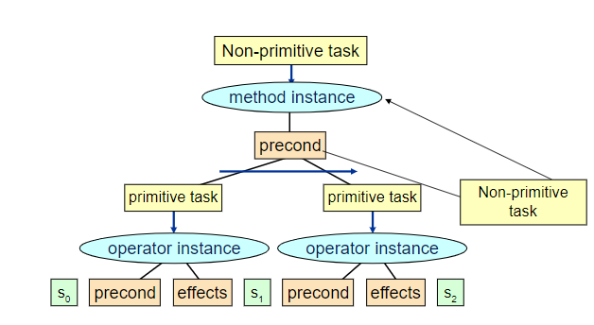
Decomposition
Compound tasks can be decomposed into simpler tasks
Primitive tasks are achieved by actions
Figure 1: HTN decomposition
Notes:
➔HTN methods are only applierd when the preconditions are satisfied
Example : go_home ➔ by taxi or by car

Slide 5
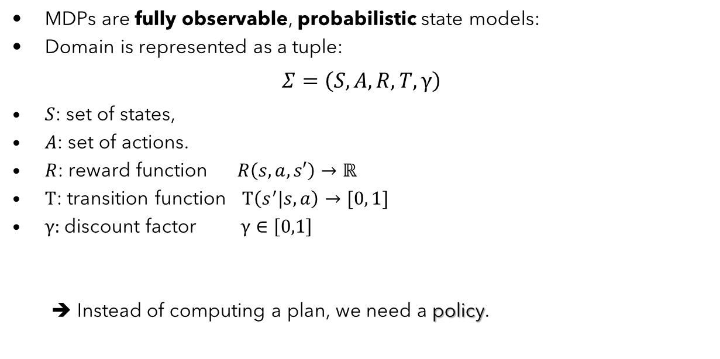
Markov Decision Processes (MDPs)
MDPs are fully observable, probabilistic state models:
Domain is represented as a tuple:
$$Σ=\left(S,A,R,T,γ\right)$$
$S$: set of states,
$A$: set of actions.
$R$: reward function $R\left(s,a,s′\right)→ℝ$
$T$: transition function $T\left(s^{′}|s,a\right)→[0, 1]$
$γ:$discount factor $γ∈\left[0,1\right]$
➔ Instead of computing a plan, we need a policy.
Notes:
Actions cause stochastic transitions. • Actions have costs/rewards.
initial state is known and fully observable ,
and actions are stochastic
describing the reward that the agent receives when it performs action a in state s and ends up in state s

Slide 6
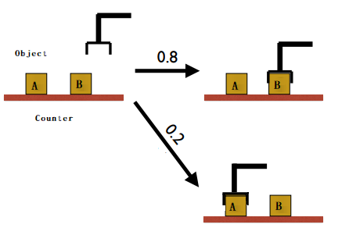
Example
Figure 2: HTN decomposition
Notes:
0.8 probability to reach its intended effect
0.2 probability to pick up the wrong object

Slide 7
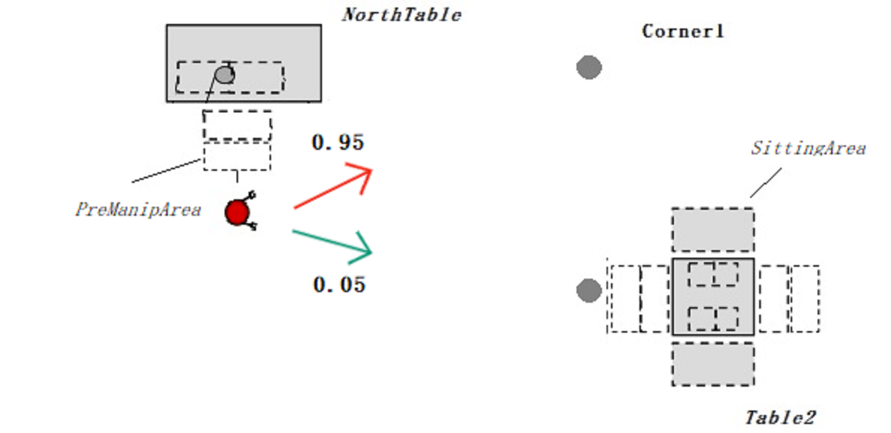
Example
Figure 3: HTN decomposition
Notes:
0.95 probability to reach its intended effect
0.05 probability to move at right angles of the intended direction

Slide 8
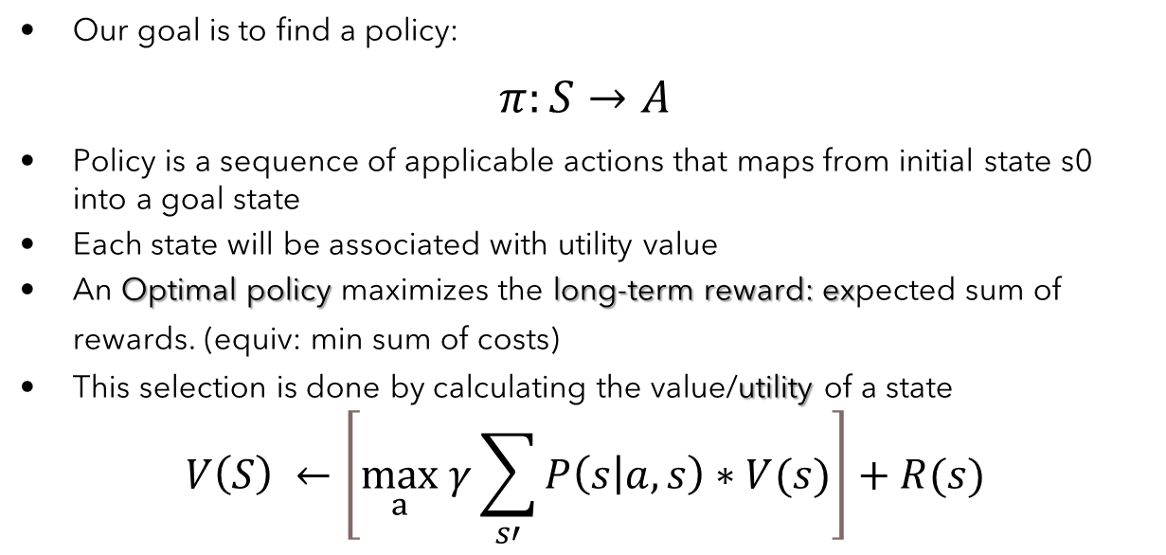
MDPs
Our goal is to find a policy:
$$π:S→A$$
Policy is a sequence of applicable actions that maps from initial state s0 into a goal state
Each state will be associated with utility value
An Optimal policy maximizes the long-term reward: expected sum of rewards. (equiv: min sum of costs)
This selection is done by calculating the value/utility of a state
$$V\left(S\right) ←\left[\max_{a} γ\sum_{s′}{P\left(s | a,s\right)∗V(s)}\right]+R(s)$$
Notes:
Policy generally specifies what the agent should do for any state
If this mapping selects the action that leads to the long-term maximum reward, then the policy is optimal

Slide 9
Back to CHIMP (Conflict-driven Hierarchical Meta-CSP Planner)
HTN planner with hybrid reasoning
Overcome the large hybrid search by extending it with hierarchical task decomposition strategy
Combine causal knowledge, temporal knowledge and resource
A CSP-style backtracking search is used to find a temporally and symbolically consistent plan
➔ Note that CHIMP description does not contain the structure of MDP
➔ Assumed closed world environment (Predictable world)
Notes:
initial state is known and fully observable ,
and actions are deterministic or(predictable)
Hybrid planning will be formulated as meta-csp
The hybrid requirement will be represented as Constraint Satisfaction Problem (CSP). A constraint network consists of a finite setof variables, a set of domains of these variables and a set of constraints,
Global consistency means we need to hv consistency in every knowledge aspect ( temporal, spatial ,,,)
We need to combine the structure and probabilistic planning➔in details we extend the chimp description with mdp structure

Slide 10
CHALLENGES & LIMITATIONS
Does not model Uncertainty (no probabilities).
Does not consider a more general models.
Solution:
➔ Combine the existing HTN structure with an MDP solver.
Issues raised:
How can we represent reward and action behaviors in the hierarchical planning (CHIMP)?
How to get all the possible states from HTN?
Why can’t we reject HTN altogether and only use MDPs?
Notes:
How can HTNs be modelled as MDPs?
Similar logic as with CHIMP , we use HTN tp Overcome the large MDP state space

Slide 11
CHALLENGES & LIMITATIONS
Hierarchical Task Network (CHIMP)
States are not enumerated exhaustively
State consists of properties of the environment
Each action modifies properties of the environment
Set of actions induces a smaller state space
Markov Decision Process
MDP domain explicitly enumerates all relevant states
Implicitly represent the same properties expressed in HTN state
MDP solver must consult the entire state space
Astronomically large: difficult to solve if the problem is very complex (hundreds of state variables)
Notes:
The planning is done offline based on the assumption that all the actions are deterministic
Spoon inside a cup

Slide 12
From HTN to MDP
Expansion
Generate States
Generate transition functions
Generate reward function

Slide 13
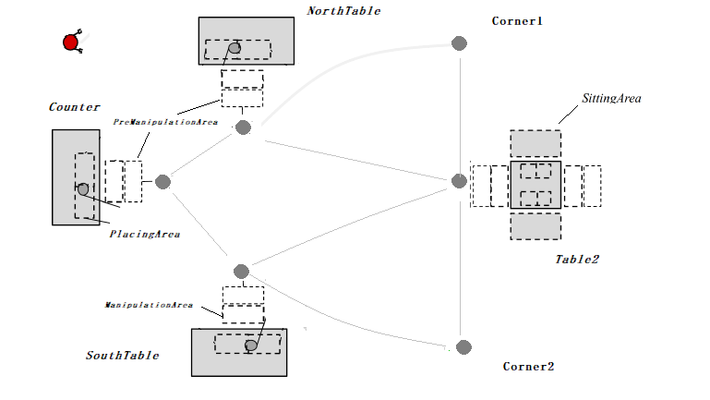
From HTN to MDP (Expansion)
The idea here is to fully expand the HTN domain into graph:
Defined by tasks (vertices) and ordering constraints (edges)
Each primitive task induces a state
This expansion starts with adding an initial state to the task network
The failure condition for this algorithm is the same as it is for the HTN planning algorithm.
➔ Obtain a conversion scheme that maintains the properties of the plan paths described by the HTN
Figure 4: HTN decomposition
Notes:
, so if an HTN isn’t solvable, then the resulting MDP will not reach desirable solution

Slide 14
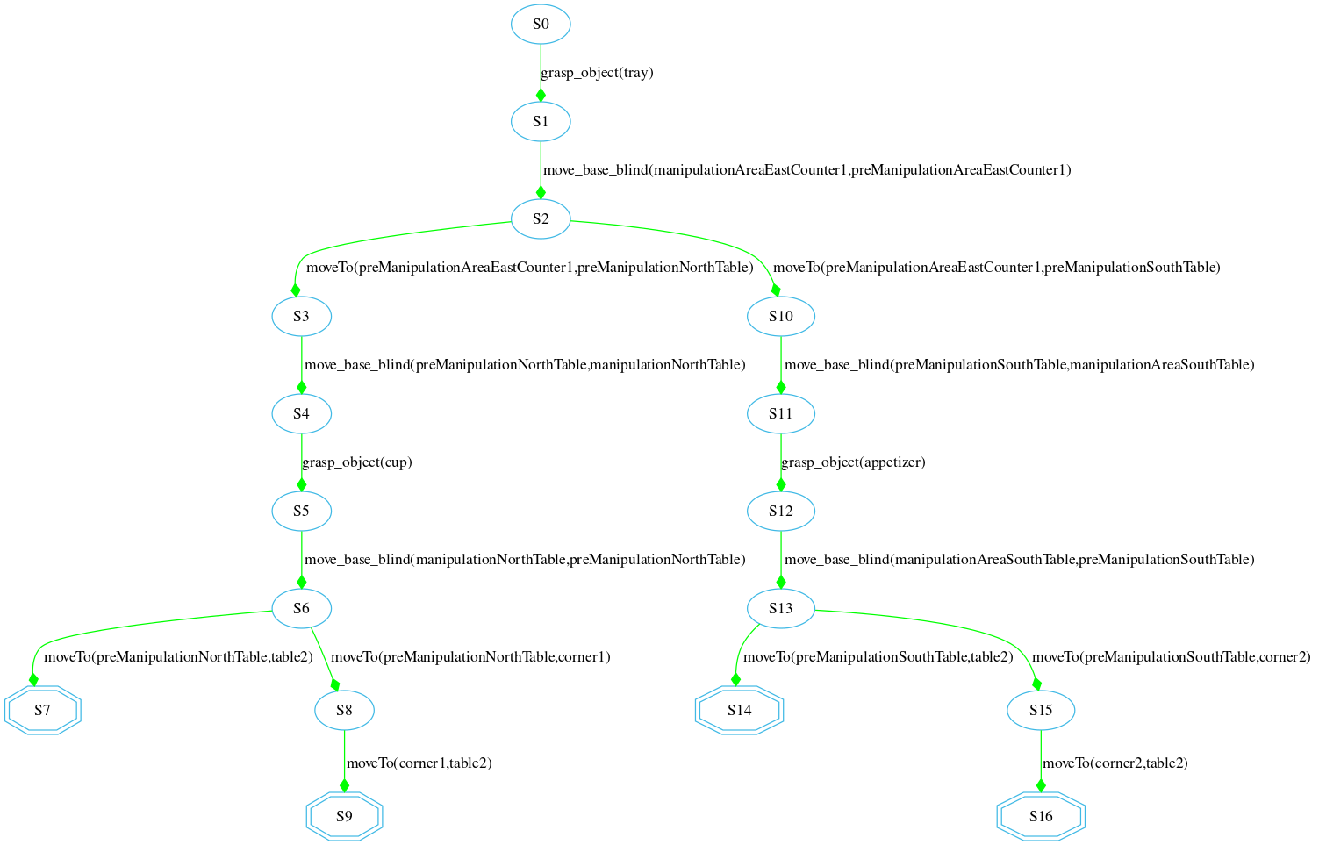
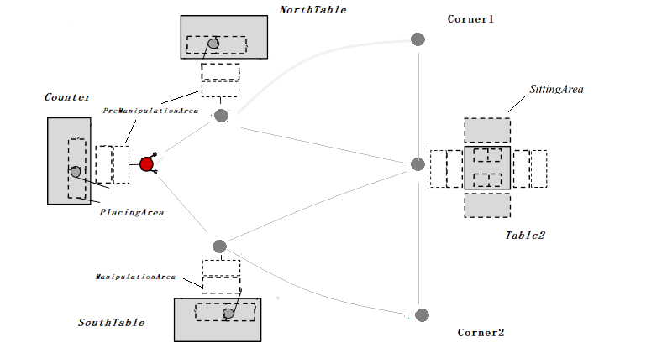
Expansion Examples: drive_robot() (from Counter)
Decompose task through methods in the domain until primitive tasks are reached
Figure 5: Fully decomposed HTN

Slide 15
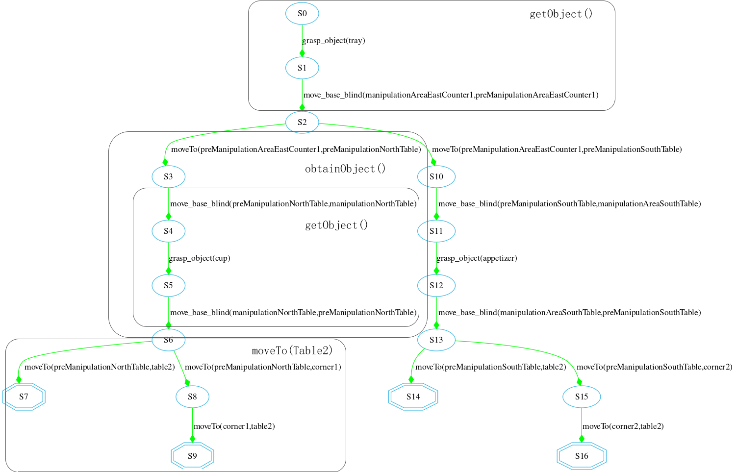
Figure 6: Fully decomposed HTN (with primitive tasks)
Notes:
All the methods will be decomposed until only primitive éléments are left

Slide 16
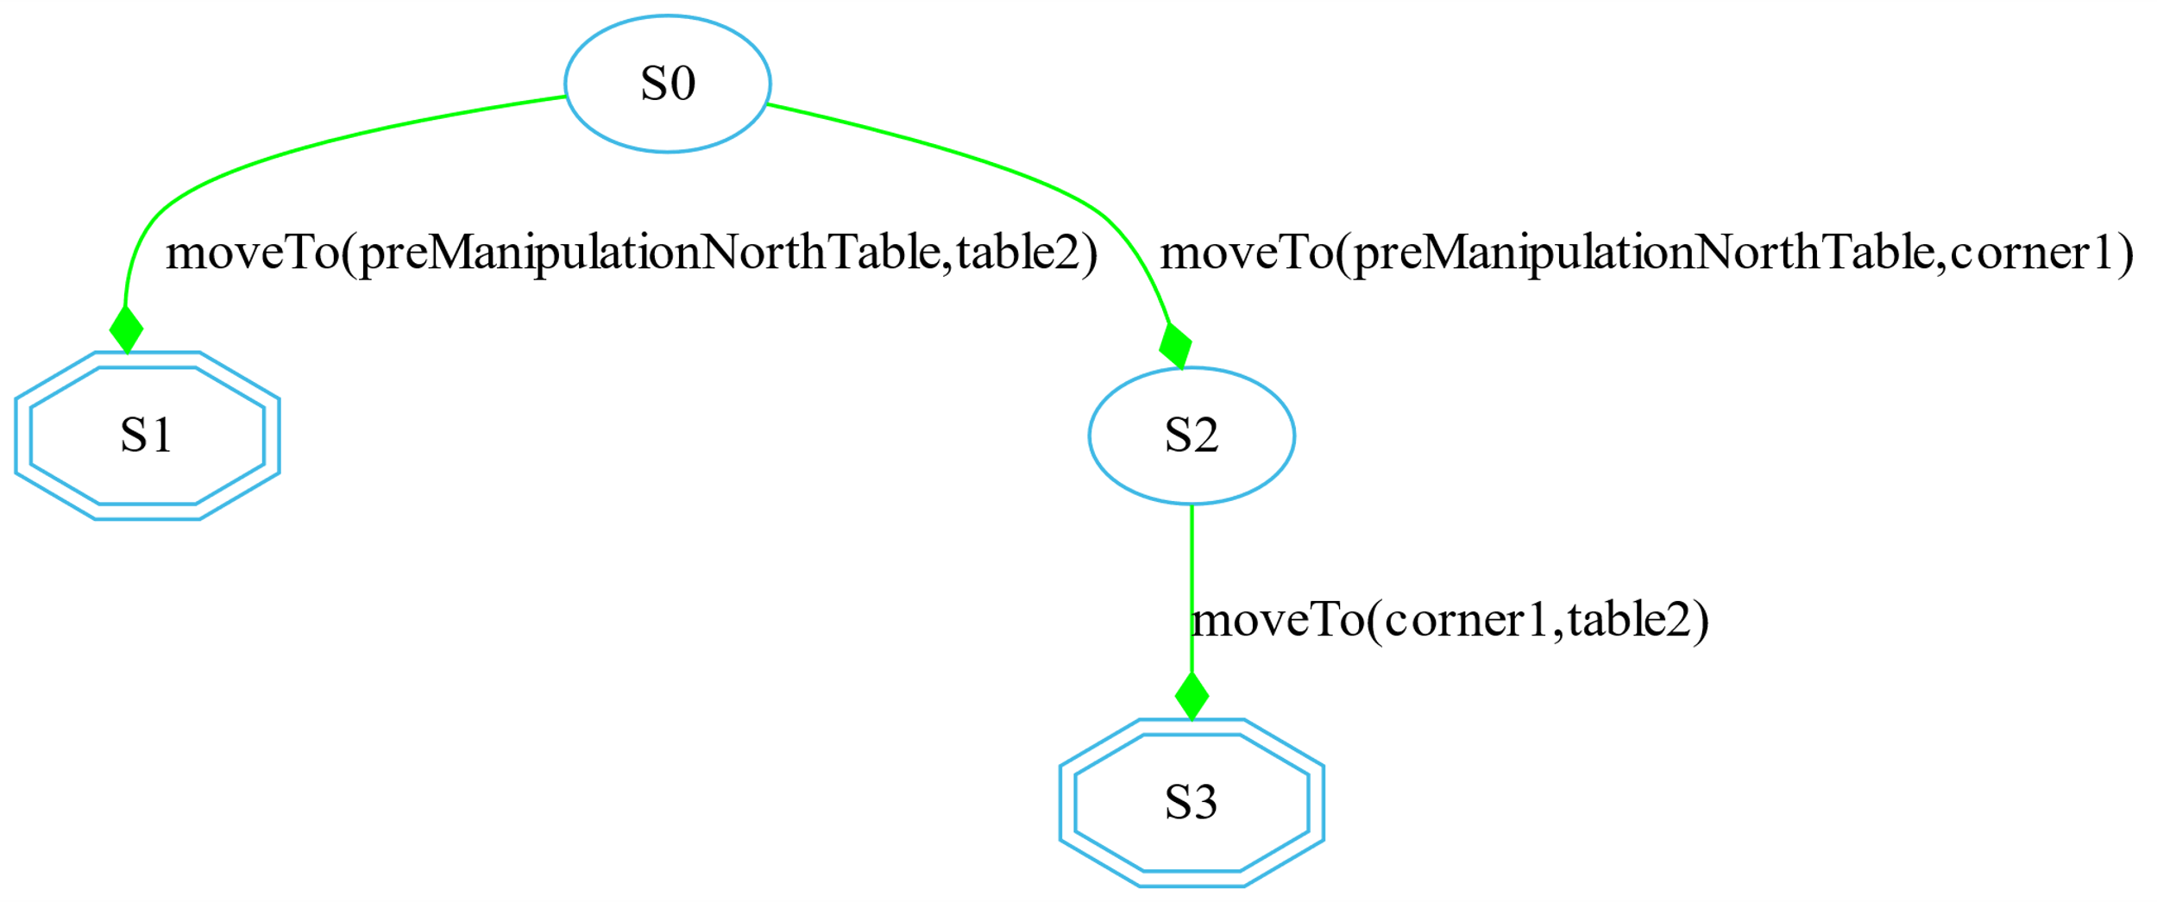
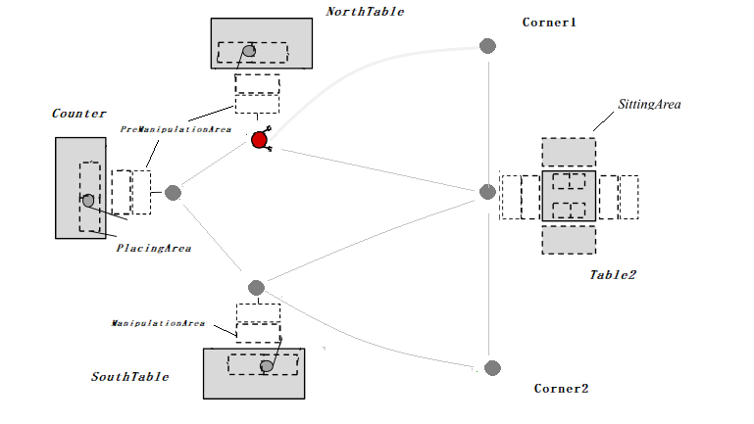
Expansion Examples: drive_robot() (from northTable)
The HTN decompositions depends also on the initial problem description
Figure 7: HTN decomposition from NorthTable

Slide 17
States Génération
State-Spaces comes from the reachable primitive tasks in the fully expanded HTN
All expanded HTN states will be used as input for MDP solver
Each primitive task in the fully decomposed HTN is considered to represent the state achieved immediately after executing the action associated with it
Algorithm must detect the overlapping states (for the transition functions):
Partition them so that there is no ambiguity over the current state for MDP
Notes:
For mdp consists of non-overlapping states ,
in some scenarios we could have states with the same axioms or features , as an abstract example,

Slide 18
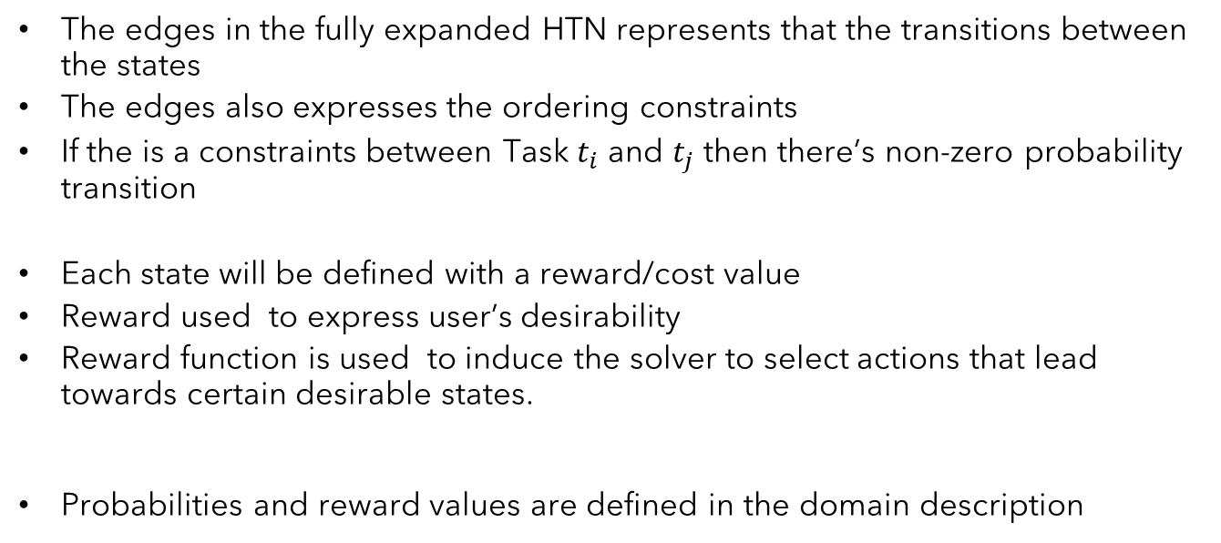
Transition Functions / Reward Génération
The edges in the fully expanded HTN represents that the transitions between the states
The edges also expresses the ordering constraints
If the is a constraints between Task $t_{i}$ and $t_{j}$ then there’s non-zero probability transition
Each state will be defined with a reward/cost value
Reward used to express user’s desirability
Reward function is used to induce the solver to select actions that lead towards certain desirable states.
Probabilities and reward values are defined in the domain description
Notes:
Reward function in an MDP is to induce the solver to select actions that lead an agent towards certain desirable states.

Slide 19
Operator (CHIMP)
(:operator
(Head !pick_up_object(?obj ?arm))
(Pre p1 On(?obj ?fromArea))
(Pre p2 RobotAt(?mArea))
(Pre p3 Holding(?arm ?nothing))
(Del p1)
(Del p3)
(Add e1 Holding(?arm ?obj))
(Constraint During(task,p2))
(Constraint Meets(p4,e1))
(Constraint Duration[4000,INF](task))
(ResourceUsage
(Usage armManCapacity 1)))
Primitive task
Precondition
Effect
Temporal Constraints
Resource fluents
Notes:
As small demonstration
Robot should be at the table the whole time
In operator , we hv the possiblity to specifiy the duration

Slide 20
Operator (CHIMP)
(:operator
(Head !pick_up_object(?obj ?arm))
(Pre p1 On(?obj ?fromArea))
(Pre p2 RobotAt(?mArea))
(Pre p3 Holding(?arm ?nothing))
…
(Reward -0,04)
(TransitionProb 0,80)
…
(ResourceUsage
(Usage armManCapacity 1)))
Markovian inputs
Notes:
As small demonstration
Robot should be at the table the whole time
In operator , we hv the possiblity to specifiy the duration

Slide 21
The necessity of Conditional Probability
Not all states has the same reward and transition probability
Flexibility in assignment markovian parametres for each specific state and task
Figure 8: HTN decomposition

Slide 22
The necessity of Conditional Probability
Each primitive task has ist own transition probability,
Distinguish the possible operators through the if-statement.
// move from ?l1 to ?l2
(:operator
(Head !moveTo(?l1 ?l2))
....
(if (Values ?l2 london) (Reward 1)) // final state only reward
(if (Values ?l2 corner1) (Reward -0.06) (TransitionProb 0.7))
(else (Reward -0.04) (TransitionProb 1)) // all the other states
(ResourceUsage (Usage Money 30))
)
Comparaison between symbolic arguments
If the boolean expression evaluates to true, a reward and transition probability statements are then executed.
One summarized operator instead of operator for each path
Notes:
An updated form of IF-statements ( IF-THEN and IF-THEN-ELSE )
is implemented and can be used flexibly depending on the usage and
designer planning choice,

Slide 23
Deal with Diverse Knowledge (Hybrid Planning)
How to express hybrid knowledge in MDP solver?
The markovian parameters will be updated during the parameters generation based on the hybrid knowledge
Only if inconsistency is found
Use the conditional clauses to affect the reward in each state
Check resource availability
Apriori defined:
(ResourceUsage (Usage Money 40))
Calculated based on spatial knowledge:
( UnarySpatialFluent sp1 Size ( counter [4,4] [18,18] ))
( UnarySpatialFluent sp2 Size ( table2 [4,4] [18 ,18] ))
( UnarySpatialFluent sp3 At ( Counter [50,50] [54,54] [50,50] [68,68] ))
( UnarySpatialFluent sp4 At ( table1 [72,72] [76,76] [50,50] [68,68] ))
Notes:
Sevral aspects of hybrid reason are included in our approach
we fetch the remaining resource of the incoming state

Slide 24
Deal with Diverse Knowledge (Resource Reasoning)
Resource consistency is checked using TCSP solver
Manage numeric constraints and to detect inconsistencies effectivel
The constraint propagation will be done simultaneous during transition
probability generation
(if (IC ?Money > 50) (decrease Reward 0.02)
Picture of the north table and the two paths to do

Slide 25
Deal with Diverse Knowledge (Resource Reasoning)
(:operator
(Head !moveTo(?l1 ?l2))
(Pre p1 robotAt(?l1))
(Del p1)
(Add e1 robotAt(?l2))
(if (Values ?l2 table2) (Reward 1)) #table2 always is the final state
(if (Values ?l1 corner1) (Reward 1.2) (TransitionProb 0.9)) #
(if (Values ?l2 corner2) (Reward -0.04) (TransitionProb 0.9)) #
(else (Reward -0.04) (TransitionProb 0.7)) #
(if (IC ?Money > 10) (decrease (Reward 0.22))
(ResourceUsage
(Usage BatteryStorageCapacity 30))
)

Slide 26
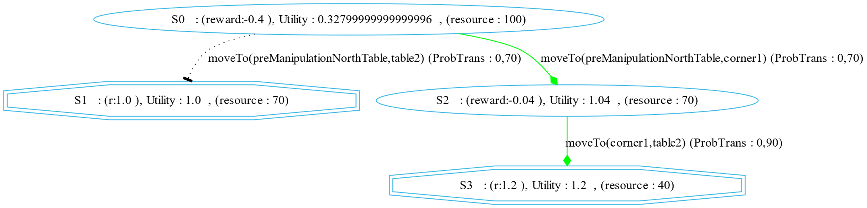
Deal with Diverse Knowledge (Resource Reasoning)
(Resource BatteryStorageCapacity 100)
Figure 9: HTN decomposition of drive_robot(Table2)
*Favorise S3

Slide 27
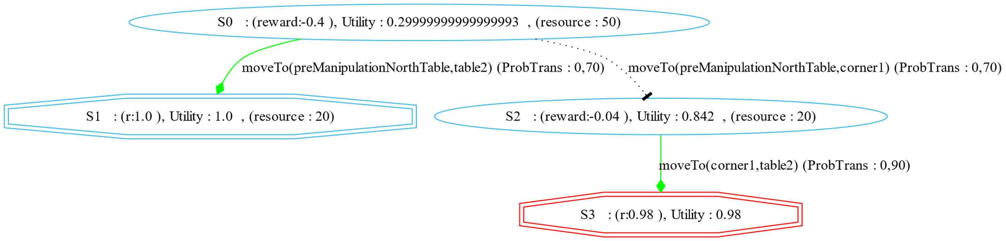
Deal with Diverse Knowledge (Resource Reasoning)
(Resource BatteryStorageCapacity 50)
Figure 9: HTN decomposition of drive_robot(Table2)
*Red octagon indicates inconsistent state

Slide 28
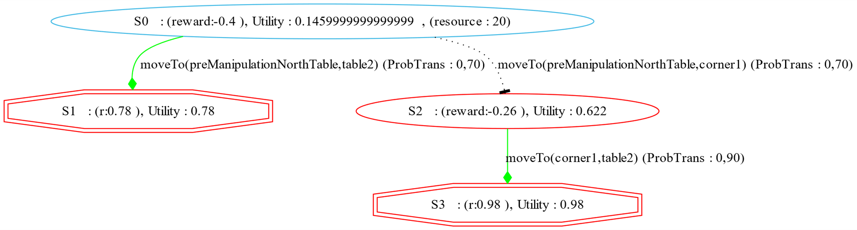
Deal with Diverse Knowledge (Resource Reasoning)
(Resource BatteryStorageCapacity 20)
Figure 9: HTN decomposition of drive_robot(Table2)
*No Solution

Slide 29
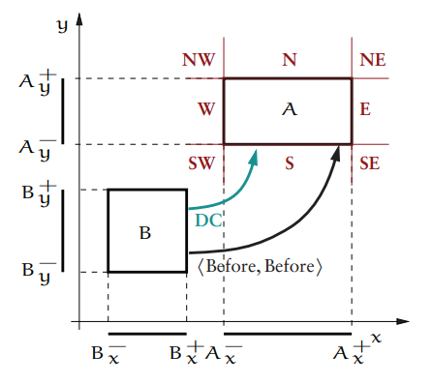
Deal with Diverse Knowledge (Spatial Reasoning)
Unary Constraints:
Size [Lx, Ux], [Ly, Uy]
At [Lx1, Ux1], [Lx2, Ux2], [Ly1, Uy1], [Ly2, Uy2]
Resource usage will be defined by spatial knowledge,
The distance between two places, will determine the resource usage,
Figure 10: Rectange Algebra example
*Implemented during the 15 ECTS research project

Slide 30
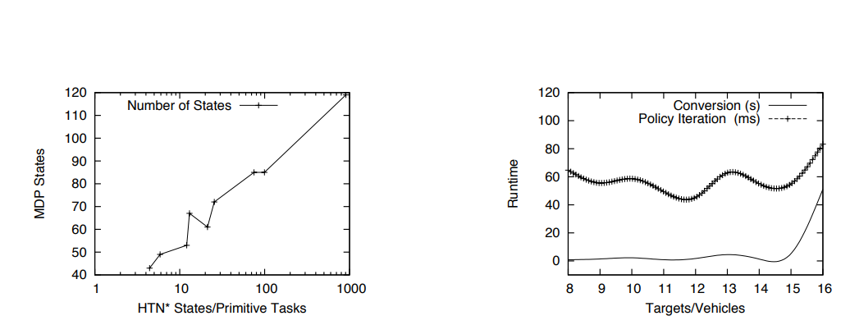
Evaluation (TODO)
Figure 11: : Results of the experiments
* Meneguzzi’s evaluation results
Notes:
For evaluation , I have not reach that point yet, that’s why I will domenstrate shortly the the result of using this approach by the original paper
as the number of primitive tasks in the fully expanded HTN explodes quite quickly, the MDP states resulting from the expansion algorithm grow much more slowly
Second we measured the runtime of the conversion process, as well as the computation of an optimal MDP policy using policy iteration with a discount factor of 1.
The runtimes in the graph of Figure 2b show that, while the conversion process is rather expensive due to the huge size of the HTN state space, the reduced state space led to very efficient MDP encodings which solved by Policy iteration algorithm

Slide 31
Conclusion
Refers mainly to the uncertainty in the planning process, with a simple action error model providing the uncertainty from the world
Maintaining the properties of the plan paths described by the HTN
Include hybrid knowledges in MDP Solver
Conversion process to bridge the gap between HTN and MDP
Extend a hybrid hierarchical task network planner to perform in a stochastic environment.
Notes:
To sum up,
New Approach to deal with uncertainty through
The main limitation is that the MDP probabilities automatically generated by our conversion process refer mainly to the uncertainty in the planning process, with a simple action error model providing the uncertainty from the world, but we envision richer ways of having this information supplied with the input.

Slide 32

Thank You For Your Attention.

Slide 33
Literature
Meneguzzi, F. e. (2011). An approach to generate MDPs using HTN representations." Decision Making in Partially Observable, Uncertain Worlds: Exploring Insights from Multiple Communities,. Barcelona, Spain.
Stock, S. (2017). Hierarchische hybride Planung für mobile Roboter.

